Slide 1


Slide 2
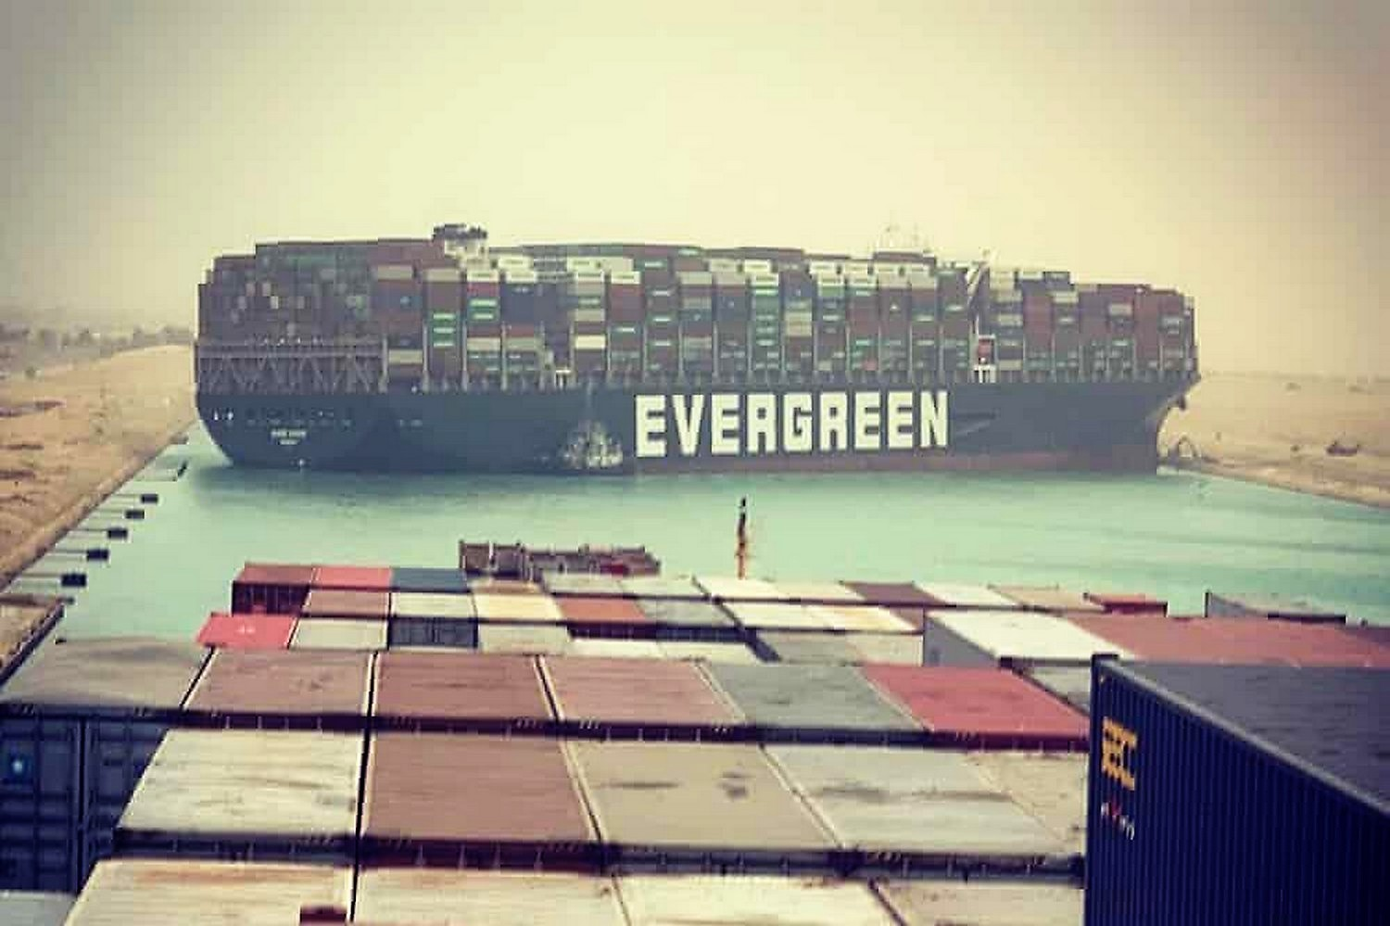

Slide 3
What are containers?
Containers provide a mechanism of “virtual” isolation
SandBox
enviroments
Applications and dependencies

Slide 4
Advantages
Portable
Consitent
Quick to deploy

Slide 5
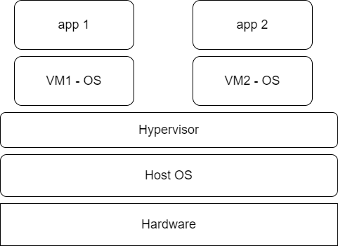
Wait, what about virtual machines?

Slide 6
App 1
App 2
App 3
Container
Centos
Debian
fedora
Docker Engine
Operating System
Server
Shares the host kernel

Slide 7
Docker containerisation platform
A free and open source tool for containerised applications:
Buiding
Deploying
Managing
*Docker Inc – A company

Slide 8
Terminologies
Images
Base and child images §§§§§§§§§§§
Hub
Docker Daemon
Docker Client

Slide 9
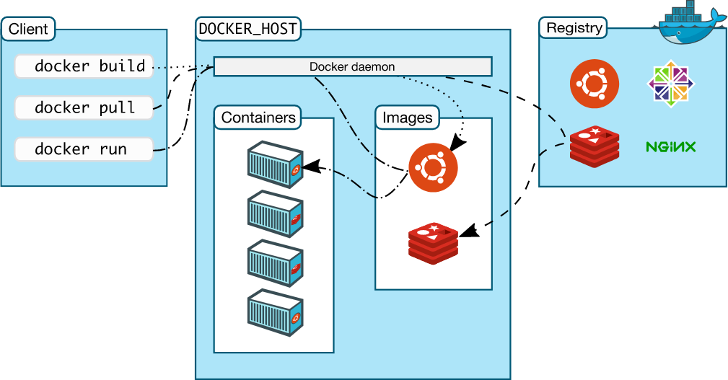
Docker Architecture

Slide 10
Practical

Slide 11
Conda
An open source package management system and environment management system that runs on Windows, macOS and Linux.
Conda quickly installs, runs and updates packages and their dependencies. It was created for Python programs, but it can package and distribute software for any language.
Docker
provides container software that is ideal for developers and teams looking to get started and experimenting with container-based applications. It provides an integrated container-native development experience; and access to the largest library of community and certified Linux and Windows Server content from Docker Hub.
Singularity
Enables users to have full control of their environment. Singularity containers can be used to package entire scientific workflows, software and libraries, and even data.
This means that you don’t have to ask your cluster admin to install anything for you
- you can put it in a Singularity container and run.

Slide 12
Singularity
A container platform
Created to run complex applications on HPC clusters
Simple
Portable
Reproducible
Single verifiable file

